Slide 1
Orthogonal Projection
Hung-yi Lee
Notes:
TBD:
P5, P6, P9

Slide 2
Reference
Textbook: Chapter 7.3, 7.4

Slide 3
Orthogonal Projection
What is Orthogonal Complement
What is Orthogonal Projection
How to do Orthogonal Projection
Application of Orthogonal Projection

Slide 4

Orthogonal Complement
The orthogonal complement of a nonempty vector set S is denoted as S⊥ (S perp).
S⊥ is the set of vectors that are orthogonal to every vector in S
$$S^{\text{⊥}}=\left\{v:v⋅u=0,∀u∈S\right\}$$
W⊥
S = R^{n} ⇒ S⊥ = {0}
W
S = {0} ⇒ S⊥ = R^{n}

Slide 5
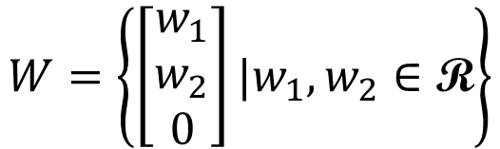

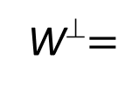

Orthogonal Complement
The orthogonal complement of a nonempty vector set S is denoted as S⊥ (S perp).
S⊥ is the set of vectors that are orthogonal to every vector in S
$$S^{\text{⊥}}=\left\{v:v⋅u=0,∀u∈S\right\}$$
$$W=\left\{\left[\begin{aligned}w_{1} \\ w_{2} \\ 0\end{aligned}\right]|w_{1},w_{2}∈\text{R}\right\}$$
V ⊆ W⊥:
for all v ∈ V and w ∈ W, v • w = 0
W⊥ ⊆ V:
$$\left\{\left[\begin{aligned}0 \\ 0 \\ v_{3}\end{aligned}\right]|v_{3}∈\text{R}\right\}$$
W⊥$=$
$$=\text{V}$$
since e₁, e₂ ∈ W, all z = [ z₁ z₂ z₃ ]^{T} ∈ W⊥ must have z₁ = z₂ = 0
Notes:
by z • e₁ = z • e₂ = 0

Slide 6



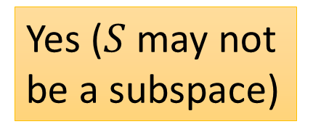










Properties of Orthogonal Complement
Yes ($S$ may not be a subspace)
Is $S^{\text{⊥}}$ always a subspace?
For any nonempty vector set S, ${\left(Span S\right)}^{\text{⊥}}=S^{\text{⊥}}$
$$W$$
$$U$$
$$v∈W$$
$$v∈U$$
$$v∈U$$
$$S=\left\{w_{1},w_{2},…,w_{k}\right\}$$
$$w_{i}∙v=0$$
$$u∈Span S$$
$$u={c_{1}w}_{1}+c_{2}w_{2}+…+c_{k}w_{k}$$
$$u∙v=\left({c_{1}w}_{1}+c_{2}w_{2}+…+c_{k}w_{k} \right)∙v$$
$$={c_{1}w}_{1}∙v+c_{2}w_{2}∙v+…+c_{k}w_{k}∙v$$
$$=0$$
$$v∈W$$
Notes:
Use the three propertites

Slide 7


Properties of Orthogonal Complement
Yes ($S$ may not be a subspace)
Is $S^{\text{⊥}}$ always a subspace?
For any nonempty vector set S, ${\left(Span S\right)}^{\text{⊥}}=S^{\text{⊥}}$
Let W be a subspace, and B be a basis of W.
$B^{\text{⊥}}=W^{\text{⊥}}$
What is ${S∩S}^{\text{⊥}}$?
Zero vector
Notes:
Use the three propertites

Slide 8

Properties of Orthogonal Complement
Example:
For W = Span{u₁, u₂}, where u₁ = [ 1 1 −1 4 ]^{T} and u₂ =[ 1 −1 1 2 ]^{T}
v ∈ W⊥ if and only if u₁ • v = u₂ • v = 0
i.e., v = [ x₁ x₂ x₃ x₄ ]^{T} satisfies
⇔
⇔
is a basis for W⊥.
W⊥
= Solutions of “Ax=0”
= Null A
Notes:
Proof You show that (a basis of W)∪(a basis of W⊥) = a basis of R^{n}.

Slide 9


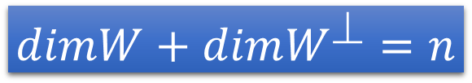
Properties of Orthogonal Complement
For any matrix A
$${\left(Row A\right)}^{\text{⊥}}=Null A$$
v ∈ (Row A)⊥ ⇔ For all w ∈ Span{rows of A}, w • v = 0
⇔ Av = 0.
${\left(Col A\right)}^{\text{⊥}}=Null A^{T}$
(Col A)⊥ = (Row A^{T}) ⊥ = Null A^{T} .
For any subspace W of R^{n}
$$dimW+dimW^{\text{⊥}}=n$$

Slide 10



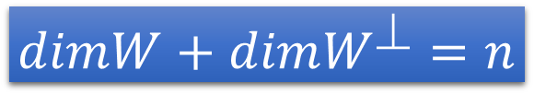
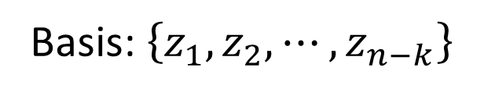


Unique
w
$$u={c_{1}w}_{1}+c_{2}w_{2}+…+c_{k}w_{k}$$
$$+{b_{1}z}_{1}+b_{2}z_{2}+…+b_{n−k}z_{n−k}$$
z
For any subspace W of R^{n}
$$dimW+dimW^{\text{⊥}}=n$$
Basis: $\left\{w_{1},w_{2},⋯,w_{k}\right\}$
Basis: $\left\{z_{1},z_{2},⋯,z_{n−k}\right\}$
Basis for R^{n}
For every vector u,
W⊥
u
u = w + z
(unique)
z
W
w
$$∈W$$
$$∈W^{\text{⊥}}$$
0

Slide 11
Orthogonal Projection
What is Orthogonal Complement
What is Orthogonal Projection
How to do Orthogonal Projection
Application of Orthogonal Projection

Slide 12
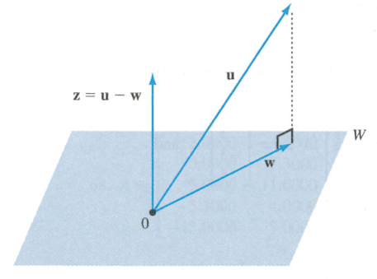




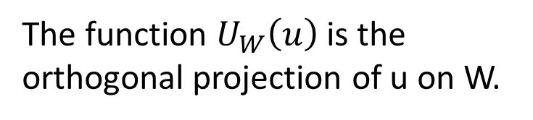
Orthogonal Projection
orthogonal projection
$$∈W^{\text{⊥}}$$
u = w + z
(unique)
$$z$$
$$∈W$$
$$∈W^{\text{⊥}}$$
Orthogonal Projection Operator:
The function $U_{W}\left(u\right)$ is the orthogonal projection of u on W.
u = w + z
u’ = w’ + z’
Linear?
ku = kw + kz
u+u’ = (w+w’) + (z+z’)

Slide 13


Orthogonal Projection
w in subspace W is “closest” to vector u.
$$∈W^{\text{⊥}}$$
$$z$$
“closest”
Always orthogonal
z is always orthogonal to all vectors in W.

Slide 14
Closest Vector Property
Among all vectors in subspace W, the vector closest to u is the orthogonal projection of u on W
u
∀ w, w′, w − w′ ∈ W.
⇒ (u − w) • (w − w′) = 0.
⇒ ||u − w′||²
= ||(u − w) + (w − w′)||²
= ||u − w||² + ||w − w′||²
> ||u − w||²
w
w’
0
w = U_{W}(u)
W
The distance from a vector u to a subspace W is the distance between u and the orthogonal projection of u on W

Slide 15


Orthogonal Projection Matrix
Orthogonal projection operator is linear.
It has standard matrix.
Orthogonal Projection Matrix P_{w}
u
z = u - w
w = U_{W}(u)
$$=P_{W}u$$
0
v = U_{W}(v)
$$=P_{W}v$$
W
Notes:
Proposition: U_{W} is linear.
Proof If U_{W}(u₁) = w₁ and U_{W}(u₂) = w₂, then ∃ unique z₁, z₂ ∈W⊥
such that u₁ = w₁+z₁ and u₂ = w₂+z₂ ⇒ u₁+u₂ = w₁+w₂ + z₁+z₂
⇒ U_{W}(u₁+u₂) = w₁+w₂ since w₁+w₂ ∈W and z₁+z₂ ∈W⊥
Similarly U_{W}(cu) = cw ∀c, u

Slide 16
Orthogonal Projection
What is Orthogonal Projection
How to do Orthogonal Projection
Application of Orthogonal Projection
What is Orthogonal Complement

Slide 17
Orthogonal Projection on a line
Orthogonal projection of a vector on a line
$$z∙u=0$$
v
v: any vector
u: any nonzero vector on L
w: orthogonal projection of
v onto L , w = cu
z: v − w
z
L
z
u
w
$$\left(v−w\right)∙u$$
$$=\left(v−cu\right)∙u$$
$$=v∙u−cu∙u$$
$$=v∙u−c{\left\|u\right\|}^{2}$$
$$c=\frac{v∙u}{{\left\|u\right\|}^{2}}$$
$$w=cu=\frac{v∙u}{{\left\|u\right\|}^{2}}u$$
=0
Distance from tip of v to L :
$$=\left\|v−\frac{v∙u}{{\left\|u\right\|}^{2}}u \right\|$$
$$\left\|z\right\|=\left\|v−w\right\|$$
Notes:
W in terms of u
Tip: 頂端；尖端

Slide 18



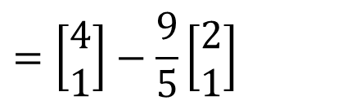



Orthogonal Projection
$$c=\frac{v∙u}{{\left\|u\right\|}^{2}}$$
$$w=cu=\frac{v∙u}{{\left\|u\right\|}^{2}}u$$
Example:
$$z∙u=0$$
v
z
L is y = (1/2)x
L
z
u
$$v=\left[\begin{aligned}4 \\ 1\end{aligned}\right]$$
$$u=\left[\begin{aligned}2 \\ 1\end{aligned}\right]$$
w
$$w=\frac{v∙u}{{\left\|u\right\|}^{2}}u$$
$$=\frac{9}{5}\left[\begin{aligned}2 \\ 1\end{aligned}\right]$$
$$=\left[\begin{aligned}4 \\ 1\end{aligned}\right]−\frac{9}{5}\left[\begin{aligned}2 \\ 1\end{aligned}\right]$$
$$z=v−w$$
Notes:
$$w=\frac{v∙u}{{\left\|u\right\|}^{2}}u$$
$$=\frac{9}{5}\left[\begin{aligned}2 \\ 1\end{aligned}\right]$$
$$\left\|\left[\begin{aligned}4 \\ 1\end{aligned}\right]−\frac{9}{5}\left[\begin{aligned}2 \\ 1\end{aligned}\right]\right\|$$
$$=\frac{1}{5}\left\|\left[\begin{aligned}2 \\ −4\end{aligned}\right]\right\|$$
$$=\frac{2}{5}\sqrt{5}$$

Slide 19

Orthogonal Projection Matrix
Let C be an n x k matrix whose columns form a basis for a subspace W
$$P_{W}=C{\left(C^{T}C\right)}^{−1}C^{T}$$
n x n
nxk
kxn
nxk
kxn
Proof: Let u ∈ R^{n} and w = U_{W}(u).
Since W = Col C, w = Cb for some b ∈ R^{k}
and u − w ∈W⊥
⇒ 0 = C^{T}(u − w) = C^{T}u − C^{T}w = C^{T}u − C^{T}Cb.
⇒ C^{T}u = C^{T}Cb.
⇒ b = (C^{T}C)⁻¹C^{T}u and w = C(C^{T}C)⁻¹C^{T}u as C^{T}C is invertible.

Slide 20

Orthogonal Projection Matrix
Let C be an n x k matrix whose columns form a basis for a subspace W
$$P_{W}=C{\left(C^{T}C\right)}^{−1}C^{T}$$
n x n
Let C be a matrix with linearly independent columns. Then $C^{T}C$ is invertible.
Proof: We want to prove that C^{T}C has independent columns.
Suppose C^{T}Cb = 0 for some b.
⇒ b^{T}C^{T}Cb = (Cb)^{T}Cb = (Cb) • (Cb) = ||Cb||² = 0.
⇒ Cb = 0 ⇒ b = 0 since C has linear independent columns.
Thus C^{T}C is invertible.

Slide 21




Orthogonal Projection Matrix
Example: Let W be the 2-dimensional subspace of R³ with equation x₁ − x₂ +2x₃ = 0.
$$P_{W}=C{\left(C^{T}C\right)}^{−1}C^{T}$$
記得起來嗎?
W has a basis
$$C=$$
$$P_{W}\left[\begin{aligned}1 \\ 3 \\ 4\end{aligned}\right]=\left[\begin{aligned}0 \\ 4 \\ 2\end{aligned}\right]$$
$$P_{W}=$$

Slide 22
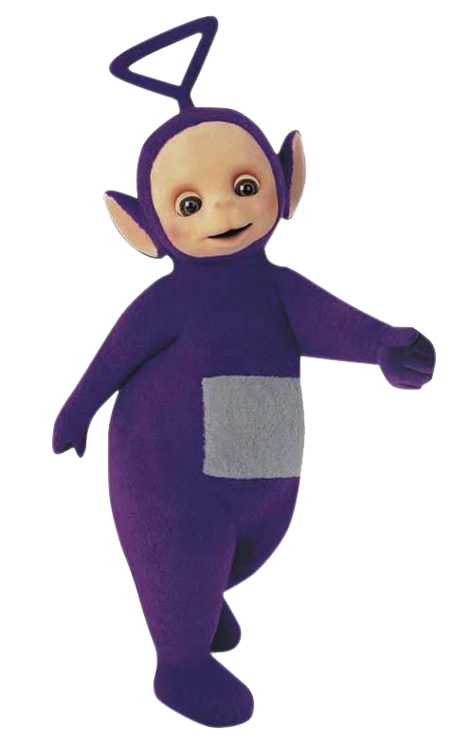
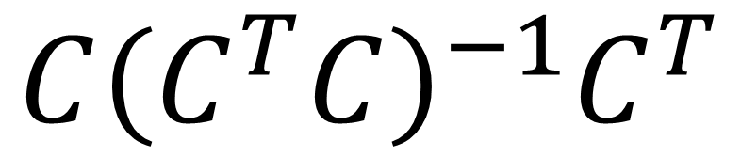
$$C{\left(C^{T}C\right)}^{−1}C^{T}$$

Slide 23



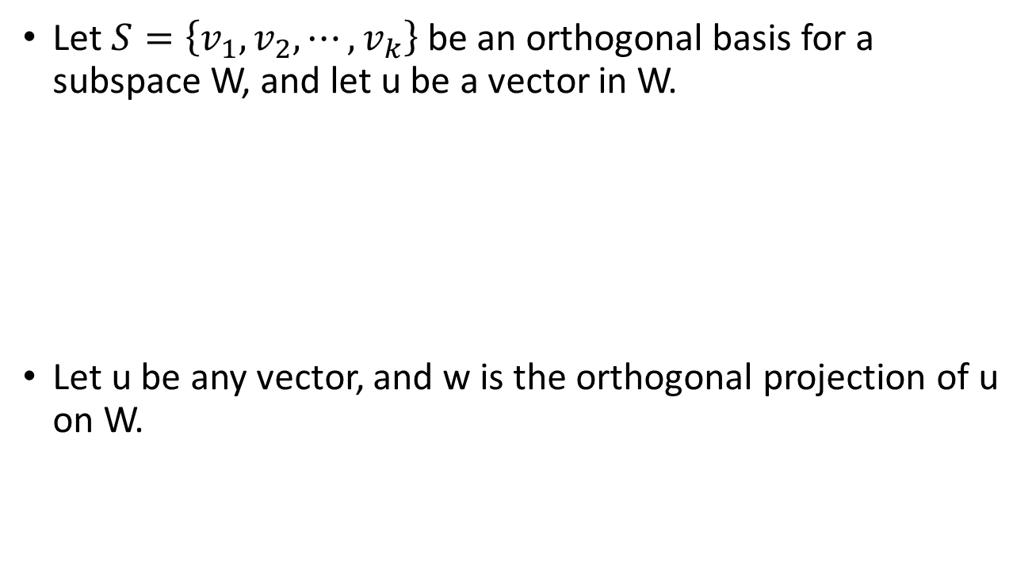





Orthogonal Projection
Let $S=\left\{v_{1},v_{2},⋯,v_{k}\right\}$ be an orthogonal basis for a subspace W, and let u be a vector in W.
Let u be any vector, and w is the orthogonal projection of u on W.
$$u=c_{1}v_{1}+c_{2}v_{2}+⋯+c_{k}v_{k}$$
$$\frac{u∙v_{1}}{{\left\|v_{1}\right\|}^{2}}$$
$$\frac{u∙v_{2}}{{\left\|v_{2}\right\|}^{2}}$$
$$\frac{u∙v_{k}}{{\left\|v_{k}\right\|}^{2}}$$
$$w=c_{1}v_{1}+c_{2}v_{2}+⋯+c_{k}v_{k}$$
$$\frac{u∙v_{1}}{{\left\|v_{1}\right\|}^{2}}$$
$$\frac{u∙v_{2}}{{\left\|v_{2}\right\|}^{2}}$$
$$\frac{u∙v_{k}}{{\left\|v_{k}\right\|}^{2}}$$

Slide 24










Orthogonal Projection
Let $S=\left\{v_{1},v_{2},⋯,v_{k}\right\}$ be an orthogonal basis for a subspace W. Let u be any vector, and w is the orthogonal projection of u on W.
$$w=c_{1}v_{1}+c_{2}v_{2}+⋯+c_{k}v_{k}$$
$$\frac{u∙v_{1}}{{\left\|v_{1}\right\|}^{2}}$$
$$\frac{u∙v_{2}}{{\left\|v_{2}\right\|}^{2}}$$
$$\frac{u∙v_{k}}{{\left\|v_{k}\right\|}^{2}}$$
$$P_{W}=C{\left(C^{T}C\right)}^{−1}C^{T}$$
$$C^{T}=\left[\begin{aligned}v_{1}^{T} \\ v_{2}^{T} \\ ⋮ \\ v_{k}^{T}\end{aligned}\right]$$
$$P_{W}=CD^{−1}C^{T}$$
$$C=\left[\begin{matrix}v_{1} & ⋯ & v_{k}\end{matrix}\right]$$
Projected:
$$w=CD^{−1}C^{T}u$$

Slide 25
Orthogonal Projection
What is Orthogonal Projection
How to do Orthogonal Projection
Application of Orthogonal Projection
What is Orthogonal Complement

Slide 26
Solution of Inconsistent System of Linear Equations
Suppose Ax = b is an inconsistent system of linear equations.
b is not in the column space of A
Find vector z minimizing ||Az − b||
b
||Ax − b||
||Az − b||
Ax
0
Az = P_{W}b
W = Col A

Slide 27
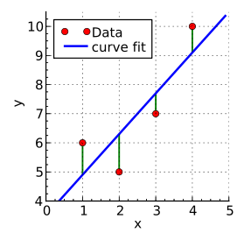
Least Square Approximation
data pairs:
x₁ → y₁
x₂ → y₂

x_{i} → y_{i}

predict
e.g.
(今天股票,明天股票)
(今天PM2.5,明天PM2.5)
Find the “least-square line” y = a₀ + a₁x to best fit the data
Regression
Notes:
Regression回歸

Slide 28
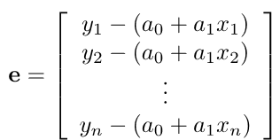





Least Square Approximation
$$y=a_{0}+a_{1}x$$
Error Vector:
$$\left(x_{i},a_{0}+a_{1}x_{i}\right)$$
$$y_{i}−\left(a_{0}+a_{1}x_{i}\right)$$
$$\left(x_{i},y_{i}\right)$$
Find a₀ and a₁ minimizing E

Slide 29

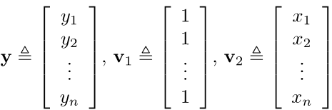

Least Square Approximation
Error Vector:
Find a₀ and a₁ minimizing E
E = ||y − (a₀v₁ + a₁v₂)||² = ||y − Ca||²

Slide 30


Least Square Approximation
Find a minimizing
E = ||y − Ca||²
B = {v₁, v₂}
Independent
Ca is the orthogonal projection of y on W = Span B .
find a such that Ca = P_{W}y
$$Ca=C{\left(C^{T}C\right)}^{−1}C^{T}y$$
$$a={\left(C^{T}C\right)}^{−1}C^{T}y$$

Slide 31
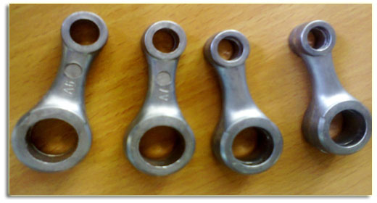
Example 1
⇒ y = 0.056 + 0.745x.
Prediction:
if the rough weight is 2.65,
the finished weight is
0.056 +0.745(2.65) = 2.030.
(estimation)
Notes:
connecting rod

Slide 32
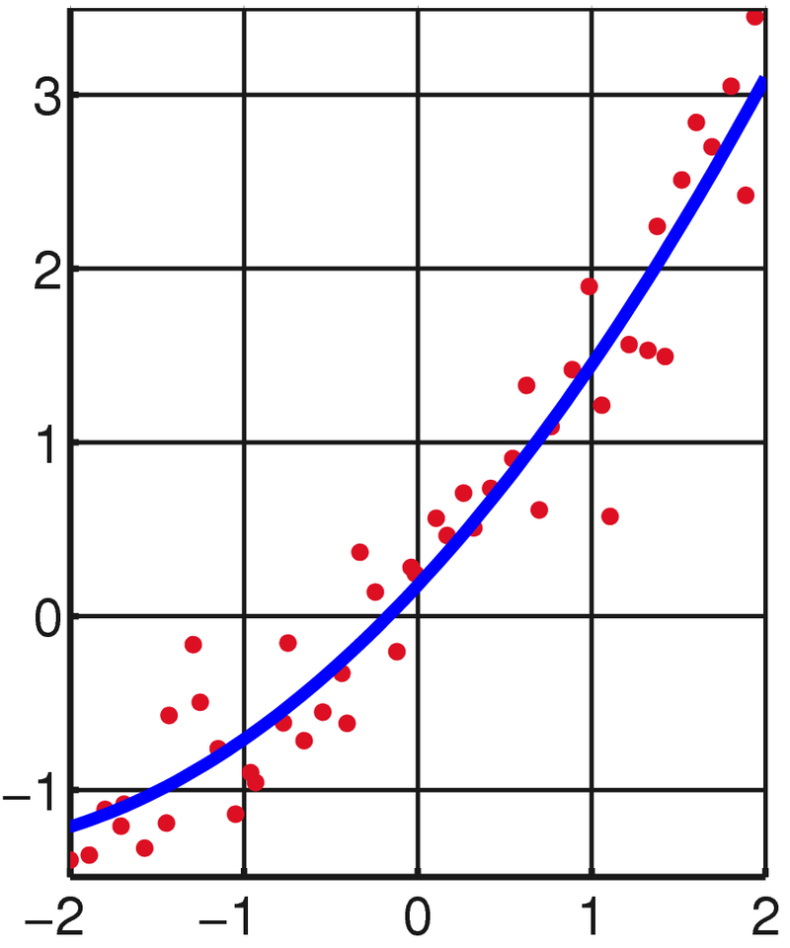

Least Square Approximation
Best quadratic fit: using y = a₀ + a₁x + a₂x² to fit the data points (x₁, y₁), (x₂, y₂), 😐, (x_{n}, y_{n})
$$e=\left[\begin{aligned}y_{1}−\left(a_{0}+a_{1}x_{1}+a_{2}x_{1}^{2}\right) \\ y_{2}−\left(a_{0}+a_{1}x_{2}+a_{2}x_{2}^{2}\right) \\ ⋮ \\ y_{n}−\left(a_{0}+a_{1}x_{n}+a_{2}x_{n}^{2}\right)\end{aligned}\right]$$
y = a₀ + a₁x + a₂x²
Find a₀, a₁ and a₂ minimizing E

Slide 33
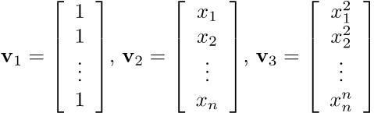


Least Square Approximation
Best quadratic fit: using y = a₀ + a₁x + a₂x² to fit the data points (x₁, y₁), (x₂, y₂), 😐, (x_{n}, y_{n})
$$e=\left[\begin{aligned}y_{1}−\left(a_{0}+a_{1}x_{1}+a_{2}x_{1}^{2}\right) \\ y_{2}−\left(a_{0}+a_{1}x_{2}+a_{2}x_{2}^{2}\right) \\ ⋮ \\ y_{n}−\left(a_{0}+a_{1}x_{n}+a_{2}x_{n}^{2}\right)\end{aligned}\right]$$
Find a₀, a₁ and a₂ minimizing E

Slide 34
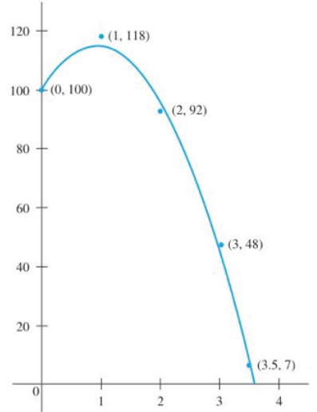


y = a₀ + a₁x + a₂x²
$$y=101.00+29.77x−16.11x^{2}$$
Best fitting polynomial of any desired maximum degree may be
found with the same method.

Slide 35
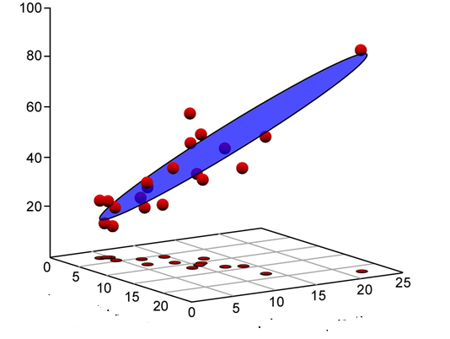




Multivariable Least Square Approximation
$$y_{A}$$
$$y_{A}=a_{0}+a_{1}x_{A}+a_{2}x_{B}$$
$$x_{A}$$
$$x_{B}$$
http://www.palass.org/publications/newsletter/palaeomath-101/palaeomath-part-4-regression-iv

